Slide 1
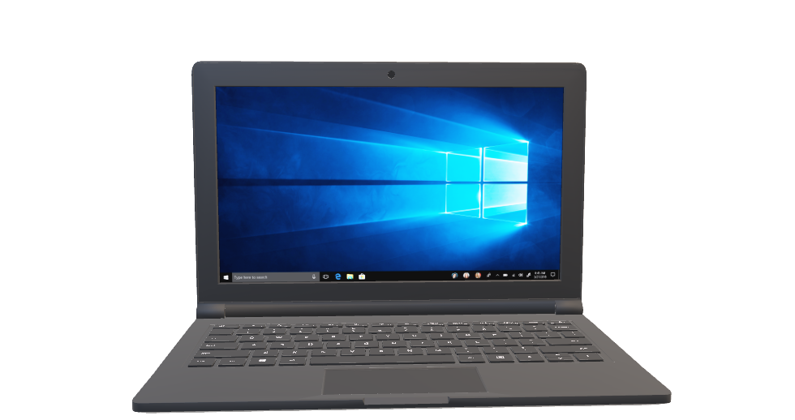
App User Manual
By Misha Bablani

Slide 2

TABLE OF CONTENTS
01.
02.
03.
Introduction
About my project
Experience
04.
05.
06.
My Internship so far
Acknowledgements
Description
My experience
Introduce myself.
All about my project that I am going to make.
About how I am doing so far in the internship
The Description
Small vote of thanks for all who have
helped me.

Slide 3
01.
Introduction

Slide 4
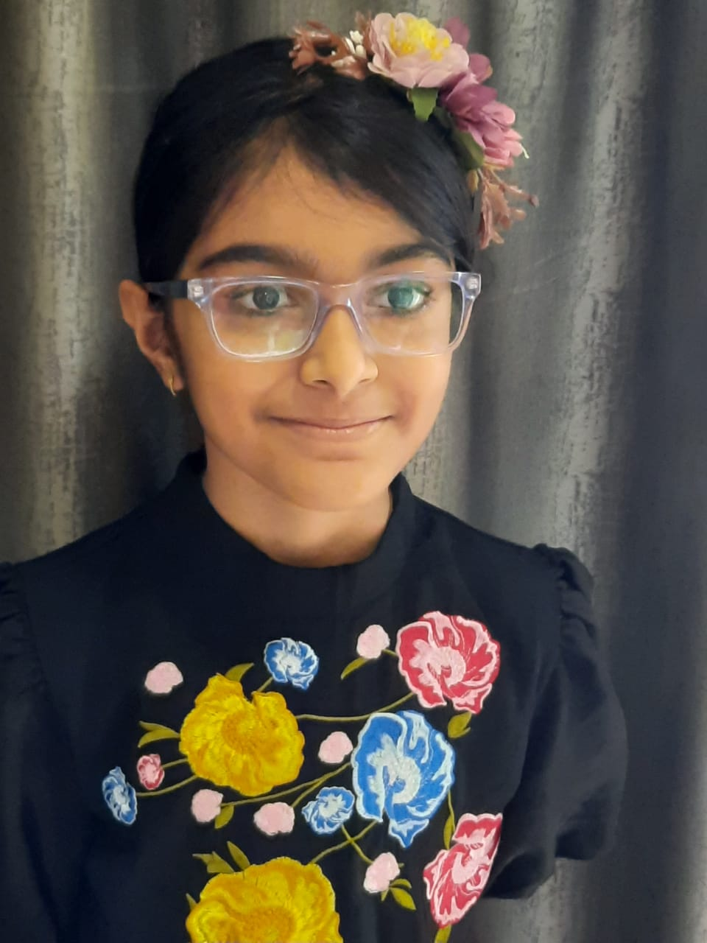
Introduction
Hi! I am Misha Bablani in grade5. I am having 3 years of experience in coding. Now I am in the AI Developer level 3. I am interested in learning more about coding.

Slide 5
My hobbies
Art
Acting
coding
Art is a calming activity for me.
Acting helps me act like new people.
Coding is like leaving all my troubles behind and jumping into virtual world.

Slide 6
02.
About my project

Slide 7
About the project
I used Python to study historical stock prices over a two-year period. After generating and saving random price data, I loaded it into Python, ensuring no missing values.
Using graphs, I visualized the stock prices and analyzed trends with rolling averages and standard deviations. I also used statistical techniques like autocorrelation to understand price patterns.
The highlight of the project was building an ARIMA model to predict future stock prices based on past data. By training and testing the model, I gained insights into financial data analysis and forecasting.
Overall, this project deepened my understanding of Python's applications in finance and data science.

Slide 8
03.
Experience

Slide 9
My mentor is the most encouraging and most helpful teacher I have ever met in a online meeting. Whenever I do something wrong he tells me whats right and what's wrong. I like the clevered site as it is easy to use and the meeting still have little technical issues but it works great.

Slide 10
04.
My Internship so far

Slide 11
My Internship
It has been a great pleasure to be in a small group for oxford. It has been my dream to go or even work in oxford and here am I attending session with you. Thank you so much for the opportunity to become one of the few student's to go to oxford.

Slide 12
05.
Goal's

Slide 13
Goal's
The goal of this project was to gain practical experience in analyzing and forecasting stock price trends using Python. By working with simulated stock price data over a two-year period, I aimed to:
Develop proficiency in data analysis techniques using pandas and matplotlib libraries.
Explore statistical methods such as autocorrelation to understand patterns in stock price data.
Implement an ARIMA model for predicting future stock prices based on historical trends.
This project provided hands-on learning opportunities in applying programming skills to financial data analysis, enhancing my understanding of data science concepts in a real-world context.

Slide 14
06.
Acknowledgements

Slide 15
Acknowledgements
I thank all who have helped me in this journey: My parents, my classmates, my mentors, my friends and my father

Slide 16
THANKS
Do you have any questions?
okmisha06@gmail.com

